Slide 1
Department of AI & DS Engineering Shree Ramchandra College of Engineering,Pune
Departmental Library
Project Guide: Prof. Ashvini Swami
By: Chaitanya Salunkhe
Sujal Rane
Sumedh Jadhav
Atharva Ringe

Slide 2
Overview
Implementation starts with entering and updating master records like Book Details, Library Information.
Any further transaction like Book Issue, Book Return will automatically update the book availability.
It will track the book details available in library and book issued to the students.

Slide 3
Introduction
Library, traditionally, collection of books used for reading or study, or the building or room in which such a collection is kept.
The word derives from the Latin liber, “book,” whereas a Latinized Greek word, bibliotheca, is the origin of the word for library in German, Russian, and the Roman languages.
Departmental Library is a library where the books related to that departmental subject are present.
In the program the user can have the idea of books and the details of the books from the program itself, instead of actual going and searching in the library.

Slide 4
Problem Statement
A library database system is an infrastructure that allows users to search books and book content, add/remove and pickup and dropdown the selected books.
A library database system reduces the manual process of book management, user registration and book borrowing.
The program can be executed fully if following conditions are mate:
1. The login credentials should match
2. The department should be AI & DS.
3. The book isbn number should be available in the library.
The book detail information is made available to the user such as book name, its author, its isbn number and its availability.
By the availability status and the isbn number the user can book an appointment for the pickup and dropdown of the book.

Slide 5
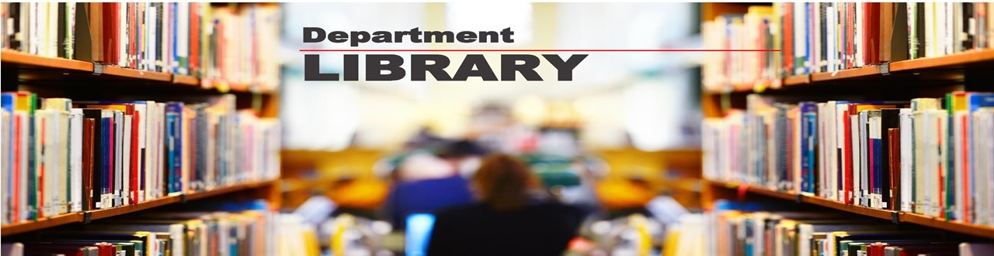
Purpose
To provide a friendly environment to maintain the details of books and library.
Improved customer service through greater access to accurate information.
Greater accountability and transparency in operations.
Departmental libraries play a crucial role in supporting the information needs of specific academic disciplines within institutions of higher education.
Unlike central libraries, departmental libraries are tailored to the unique requirements of a particular field of study or department.
This aims to explore the significance, challenges, and evolving role of departmental libraries within academic environments

Slide 6
Project Goals
Improvement in Control And Performance : The system is developed to cope up with the current issues and problems of library . The system can add user, validate user and is also bug free.
Saves Cost : After computerized system is implemented less human force will be required to maintain the library thus reducing the overall cost.
Saves Time : Librarian is able to search record by using few clicks of mouse and few search keywords thus saving his valuable time.

Slide 7
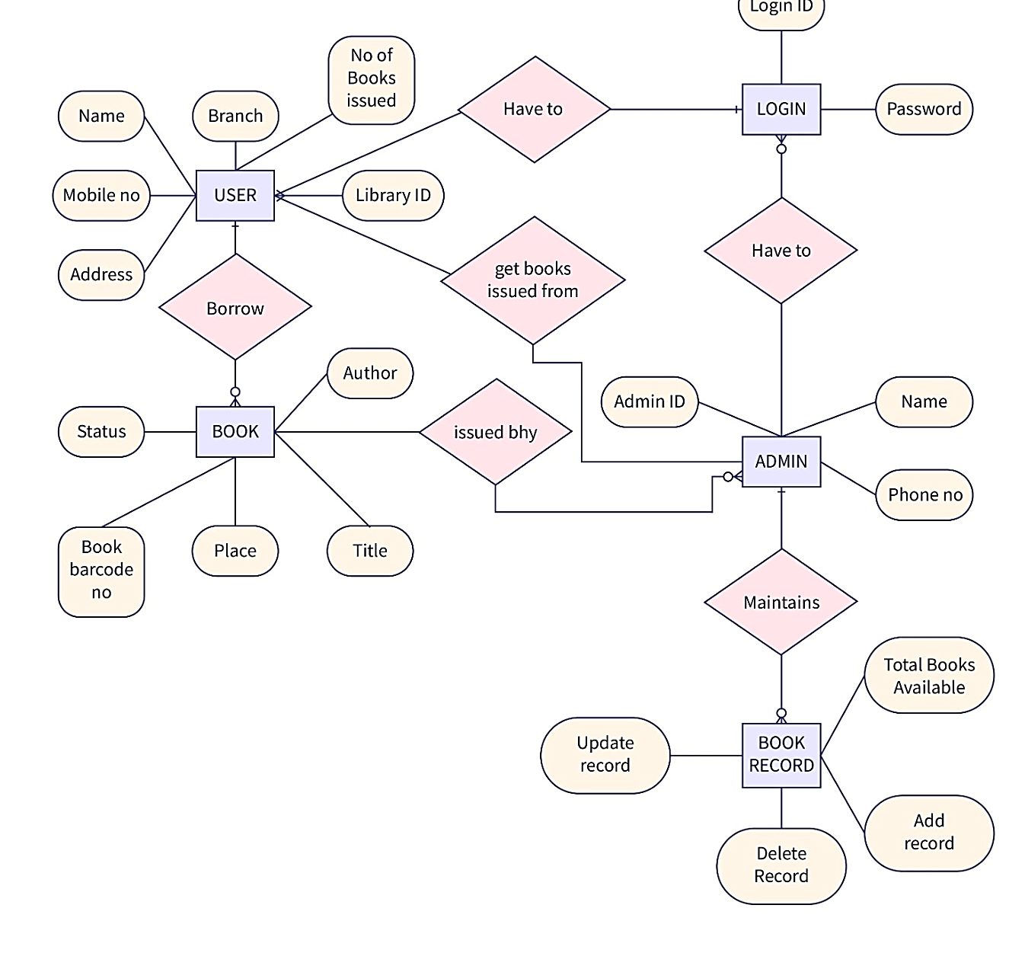
Requirements
Register New User
User Login
Register New Book
Search Book Availability
Book Issue & Return
Appointment Booking

Slide 8
Requirement Analysis
Hardware Requirements
Processor : Intel Core
Operating System : Windows7/ Ubuntu/ Windows Vista
Memory: 1 GB RAM or More
Software Requirement
Dev C++ / Visual Studio Code
Coding Language: C++

Slide 9
Characteristics
User Side :
Login Facility
Personal Information
Book Pickup Appointment
Book Drop Appointment
Book Availability

Slide 10
Characteristics
Admin/Faculty Side :
Login Facility
Personal Details
Book Pickup Appointment
Book Drop Appointment
Book Availability
Book Add & Delete Facility

Slide 11
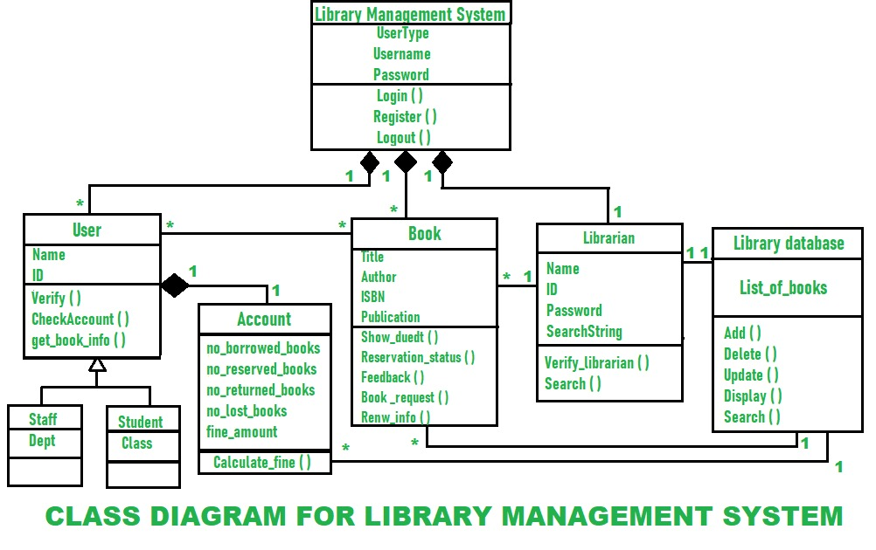
Library Management System

Slide 12
System Functions
Create an Account
Login an Account
Book Display
Book Pickup
Book Drop

Slide 13
Literature Survey
Paper 1: Researchgate Publication : Library Management System Mini Project
This paper studies the understanding and daily practice of library management system.
This project mainly focuses on online management of library
Information of books and all other details are made available in this project.
This project is working properly in the ‘Farwestern University’
Results shows that there are further improvements which can be made available.

Slide 14
Literature Survey
Paper 2: IJERT: E – Library Management System
This paper studies the understanding and daily practice of library management system.
This project mainly focuses on e - management of library
This system is made available by electronically management the library system
This project is working properly in the ‘School of Engineering @ Cochin University’
Results shows that there are further improvements which can be made available.

Slide 15
System Implementation
Login should be successful
Then personal details are entered and displayed.
There are further four function which can be accessed:
Book Pickup
Book Drop
Book Availability Display
Exit

Slide 16
Future Scope
Enhanced Digital Infrastructure
Personalized Services & Resources
Innovative Learning Spaces
Interdisciplinary Collaboration

Slide 17
Applications
Curriculum Support
Research
Information Literacy
Collaborative Learning
Faculty Support
Digital Initiatives
Interdisciplinary Engagement
Departmental Engagement
Professional Development

Slide 18
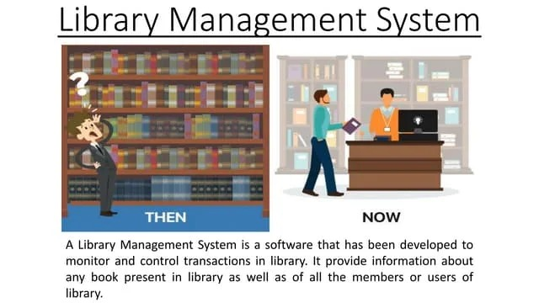
Advantages
Specialized Collections
Focused Services
Enhanced Collaboration
Convenience & Accessibility
Promotion of Discipline Support
for Departmental Goals

Slide 19
Limitations
Limited Resources
Narrow Scope
Staffing Constraints
Space Limitations
Inter-library Co-operation

Slide 20
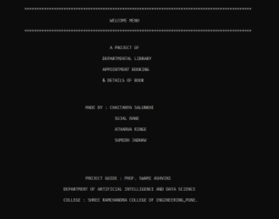
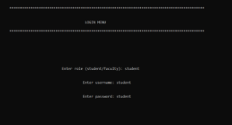
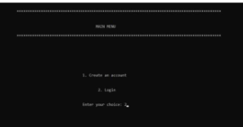
Main Menu

Slide 21
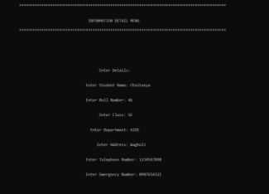
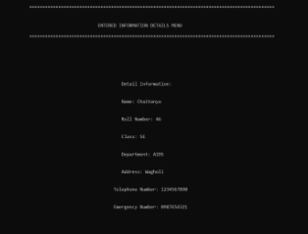
Personal Details

Slide 22
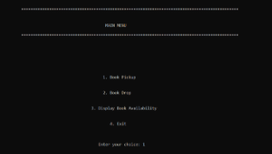
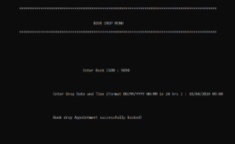
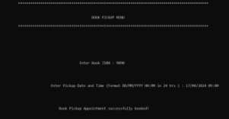
Book functions

Slide 23
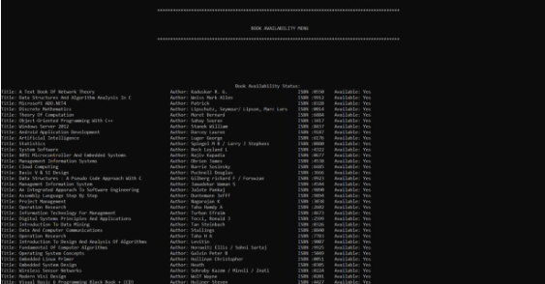
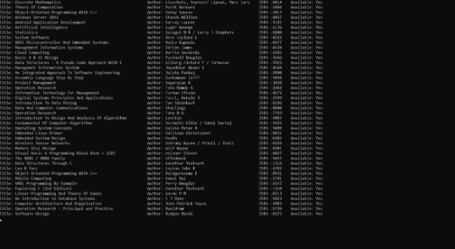
Book Avaliability

Slide 24
Conclusion
This Departmental Library System provides a computerized version of library management system which will benefit the students as well as the staff.
It makes entire process online where student can search books; staff can generate reports and do book transactions easily with the help of the system
It has a facility of faculty’s login where faculty can add new books and also remove book from library and also add details about book or events.
This system will help the students as well as the faculty.
This system has been suggested many times in different ways.
This system is been tested and works in efficient way. Overall the system works without any bugs.

Slide 25



References
http://www.google.com
http://www.youtube.com
http://www.chatgpt.com
http://www.w3schools.com
http://www.Udemy.com
http://www.srcoe.com

Slide 26


